Slide 1


Slide 2
The Creation Story
This is the Creation Story of Genesis One.

Slide 3
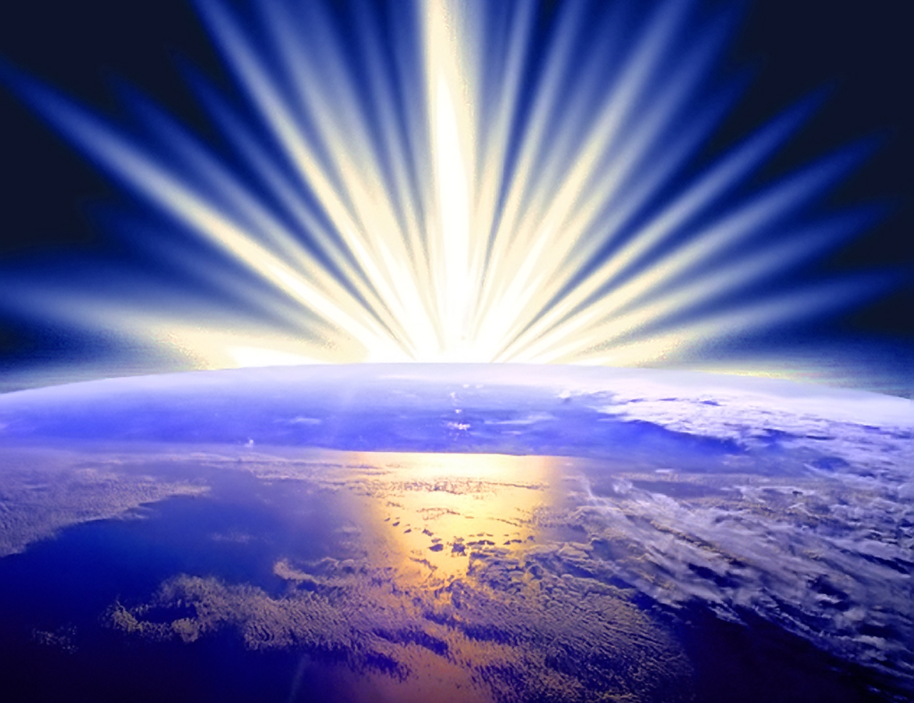
Day 1
In the beginning God created the heavens and earth.
The earth was unformed and there was darkness everywhere. The Spirit of God floated above the waters of the deep
God said, “Let there be light” and there was light
God saw that the light was GOOD. He separated the light from the dark.
God called the light ‘day’. He called the dark ‘night’. Evening passed and then it was morning
This was the first day

Slide 4
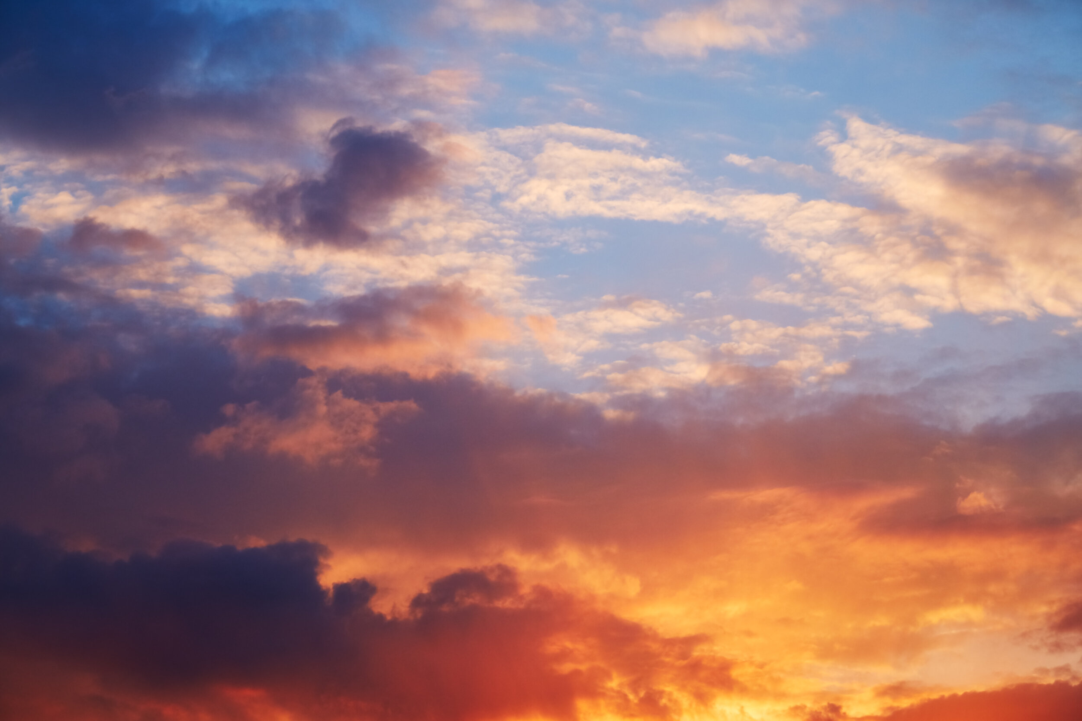
Day 2
Then God said , “A wide space will appear between the waters. So the waters will separate into two places.”
So God made a wide space. He separated the water under the space from the water that was above it
And what God said happened
God called the wide space ‘sky’
Evening passed and then it was morning.
That was the second day

Slide 5
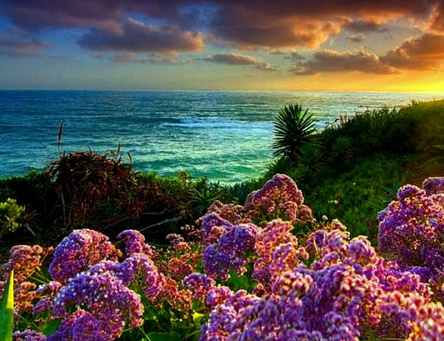
Day 3
God said, ‘The water that is under the sky will come together in one place, Then the dry ground will appear.’ And what God said happened
God called the dry ground ‘land’. He called the water that had come together ‘sea’. God looked at what he had made. He saw that it was good.

Slide 6
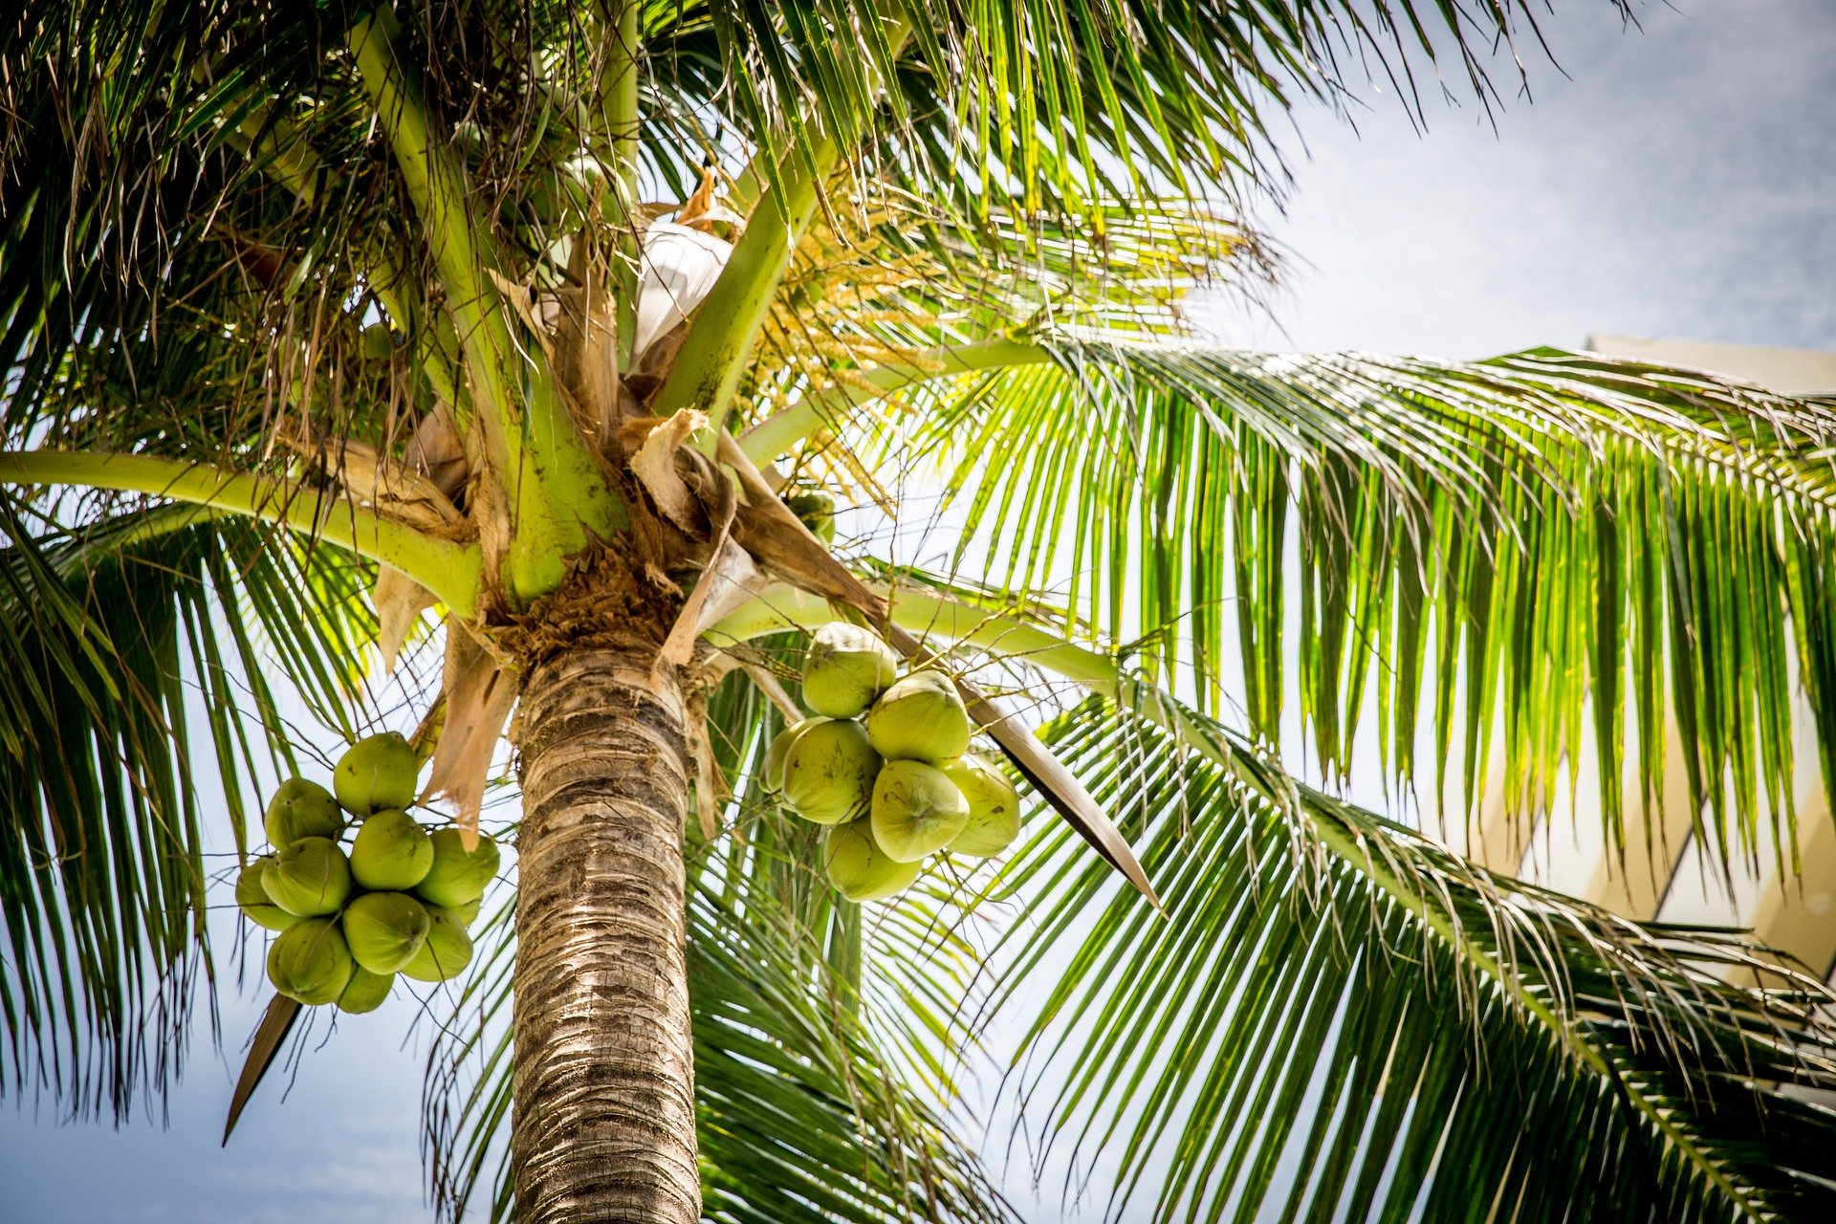
Day 3 Continued…
Then God said, ‘Let the land produce vegetation: There will be plants with their seeds, the trees with their fruits. Each kind of plant and tree will have its own seeds and fruits. And what God said happened
All kinds of plants and trees began to grow in the ground. The plants made seeds. The trees made fruits with seeds in then. Each plant made its own kind of seeds.
God looked at what he made. He saw that it was good.
Evening passed and the it was morning .
That was the third day

Slide 7
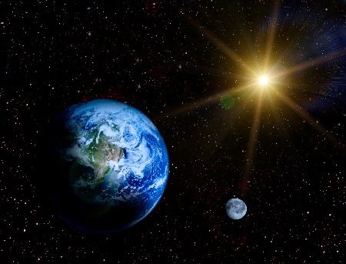
Day 4
God said, “There will be lights across the sky. They will separate the day from the night. They will show the seasons, days and years”.
“The lights in the sky will give light to the earth.”. And what God said happened.
God made two great lights. The brighter light (Sun) ruled over the day. The lesser light (Moon) ruled over the night.

Slide 8
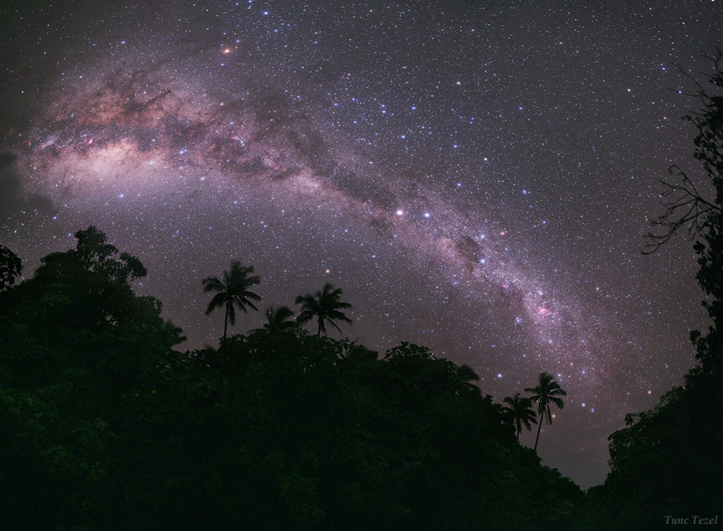
Day 4 Continued…
God said, “There will be lights across the sky.” Then God made the stars
God put all these lights in the sky to shine their light on the earth.
They were to rule over the day and night. They were to separate the time of light from the time of dark.
God looked at what he had made. He saw that it was GOOD.
Evening passed and it was morning, that was the fourth day.

Slide 9
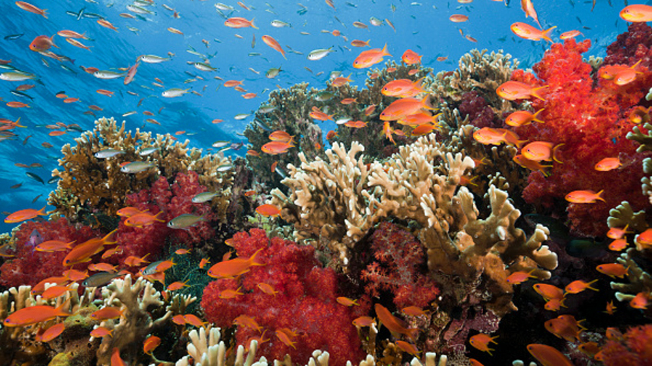
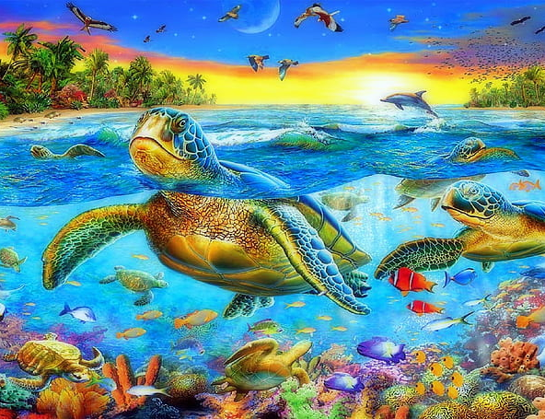
Day 5
God said, ‘The waters will become full with many living things . Birds will appear and fly above the earth, all across the sky.’
God made big animals to live in the sea. He made every different kind of living thing that filled the sea. He made every different bird to fly in the sky. God looked at what he made. He saw that it was GOOD.
God blessed all of them. He said to them, ‘Give birth to many young one, so that you grow in number. Fill all the water in the seas. The birds also should become every many, all across the earth
Evening passed and then it was morning.
That was the fifth day

Slide 10
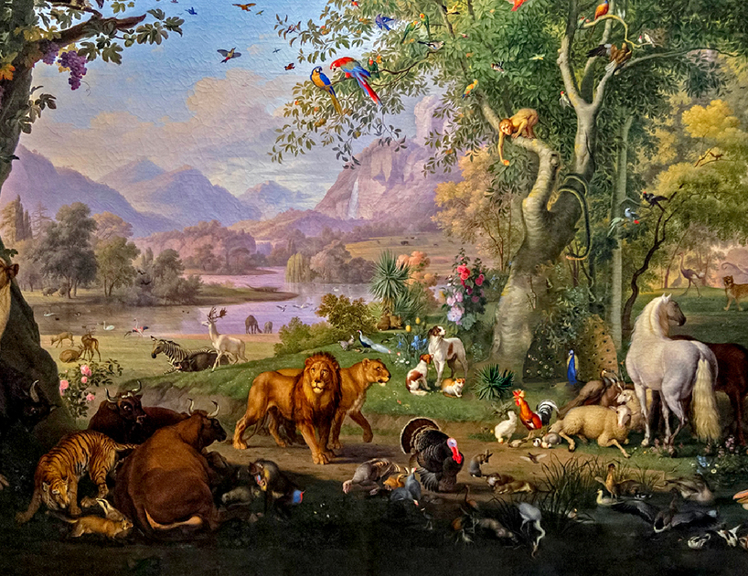
Day 6
God said, ‘Different kinds of animals will now appear on the land. There will be livestock and wild animals. There will also be other small animals that move along the ground. There will be many kinds of animals and each kind will be different.’ And what God said happened.
God made the different kinds of wild animals and the different kinds of livestock. He made all the different kinds of animals that move along the ground.
God looked at what he had made. He saw that it was GOOD.

Slide 11

Day 6
Then God said, “Let us make mankind in our image, in our likeness, so that they rule over fish in the sea and the birds in the sky , over the livestock and all the wild animals, and over all the creatures that move along the ground
So God created mankind in his own image, in the image of God he created them; male and female he created them.

Slide 12

Day 6
God blessed them and said to them, “Be fruitful and increase in number; fill the earth and subdue it. Rule over the fish in the sea and the birds in the sky and over every living creatures that moves on the ground.”
Then God said, I give you every seed-bearing plant on the face of the whole earth and every tree that has fruit with seed in it. They will be yours for food. And to all the beasts of the earth and all the birds in the sky and all the creatures that move along the ground –everything that has breath of life in it-I give every green plant for food.” And it was so
God saw all that he had made, and it was VERY GOOD. And there was evening, and there was morning. That was the sixth day.

Slide 13
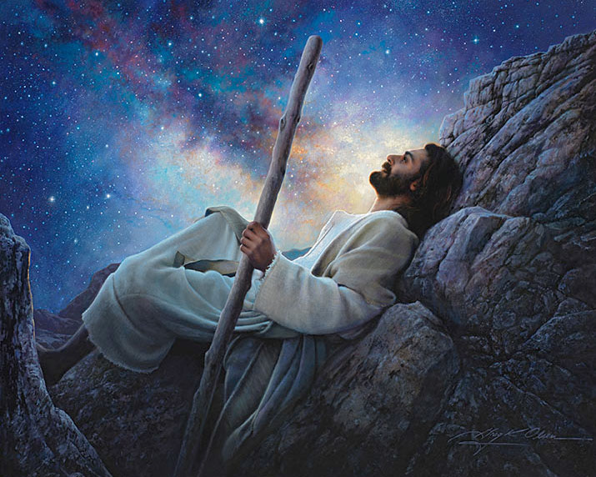
Day 7
And the heavens and the earth were finished and all that there was in them.
The seventh day came. Then God stopped the work he had been doing. He had finished his work and he rested on the seventh day.
God blessed the seventh day. And made it holy, for in it he rested from all the work which he had done.

