Slide 1

Creating a new culture in supervision
A culture of Pastoral Support and Ministry Review
Stressors in Ministry
Role ambiguity
Role overload
Role conflict
Lack of clear boundaries between work and non-work
Isolation
High effort, but little or no feedback
A strong sense of responsibility
Churches often attract people with challenging and complex pastoral needs
Empathy and compassion fatigue

Slide 2
Creating a new culture in supervision
A Culture of Pastoral Support and Ministry Review
What is Pastoral Supervision? Definition
Estadt-Barry defines it as: “A process of attending which involves, awareness, exploring, insight, and a personalized view.”
Peter-Hawkins states that: “Supervision is a joint endeavour in which practitioners with the help of a supervisor, attends to their clients and themselves, as part of their client practitioner relationships and the wider systemic context.”
According to James-Leach: “Supervision is planned intentional, boundaried space to look at, A relationship with trust, confidentiality, support and openness that gives the supervisee freedom and safety to explore issues arising, spiritual, theologically rich, supervisees world view.”
David Steele describes supervision as “an extended relationship in which supervisor and supervisees agree to meet at regular intervals for systematic reflection upon the concrete practice of pastoral care in which supervisees are engaged in order to focus all available resources on each supervisee’s personal growth in the pastoral role.”
Estadt, The Art of Clinical Supervision, 13.
Hawkins, Supervision in the Helping Professions, 5.
Leach, Pastoral Supervision, 269-270.
Steere, The Supervision of Pastoral Care, 66.

Slide 3
Creating a new culture in supervision
Managing Change (John Kotter)
Establish a sense of urgency
Create a guiding coalition
Develop a vision and strategy
Communicate the change vision
Empowering people for broad-based action
Generating short-term wins
Anchor new approaches in the culture

Slide 4
Creating a new culture in supervision
A culture of Pastoral Support and Ministry Review
Ways of promoting professional supervision
Differences between spiritual direction and supervision
Ways in which we are actively working to change the culture within the church - Research
Three tier:
Educating/Training Clergy – Ongoing Support
Educating congregation – Expectations
Church Hierarchy – Professional Development

Slide 5
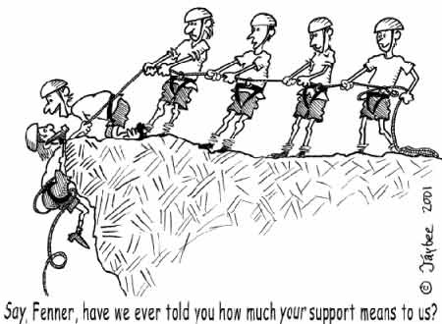

Slide 6
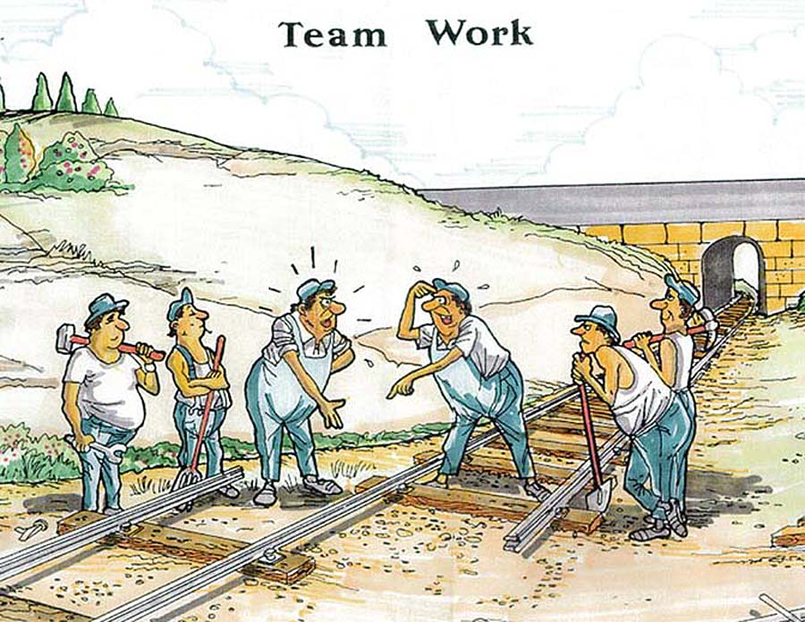

Slide 7
Individual supervision (dyadic)
Ministry setting SYSTEM
INDIVIDUAL SUPERVISION
SYSTEM
Supervisee
Case
Supervisor

Slide 8
Participative group supervision
GROUP SUPERVISION
SYSTEM
Ministry SYSTEM
Peer
Peer
Peer
Contributions to discussion encouraged
supervisee
Ministry setting
Supervisor
Contributions to discussion encouraged
Peer
Peer
Supervisor plays a key role
Peer

Slide 9
Creating a new culture in supervision
A culture of Pastoral Support and Ministry Review
Group Setting:
Appraisal vs effectiveness
Ministry review of effectiveness

Slide 10
Creating a new culture in supervision
A culture of Pastoral Support and Ministry Review
Dealing with resistance – pushback
resistance encountered
not compulsory
two types – old school

Slide 11
Creating a new culture in supervision
A culture of Pastoral Support and Ministry Review
Practical experience of changing the culture around supervision and ministry review
personal experience – young priests
highlighting the need practically within the ministry
Why?
How?

